Slide 1
Avishkar 2023
Paresh Suryakant More - PhD

Slide 2
What is Avishkar?
The Avishkar Research Convention is designed by Department of Students' Development, University of Mumbai, with the intention to develop a research culture and scientific temper among the students, scholars and teachers from under-graduate to doctoral level in the state of Maharashtra.
It is a state level intercollegiate competition

Slide 3
Why participate in Avishkar?
To develop scientific temper
To Imbibe research culture
Get Exposure
To review new dimensions of explored areas of knowledge as well as the unexplored areas of enquiry
Can avail different scholarships till completion of PhD program
National recognition of participated projects.

Slide 4
What will you learn?
Writing abstract, Manuscript etc.
Making PPT presentation and how to present in the seminars and conferences
how to do reference works
Hands on experience of over wide range of equipment and techniques

Slide 5
Levels
Level 1: Undergraduate Students (UG)
Level 2: Postgraduate Students (PG)
Level 3: Post PG Students (PPG)
Level 4: In-service Teachers (TH)

Slide 6
Streams eligible to participate in Avishkar
Science
Commerce
Arts
IT
PGDPCM

Slide 7
Categories for Avishkar
Humanities , Language and Fine Arts
Commerce, Management and Law
Pure Sciences
Agriculture and Animal Husbandry
Engineering and Technology
Medicine and Pharmacy

Slide 8
Areas Covered under each Category
Category 1: Humanities, Languages and Fine Arts It covers research areas like languages, social sciences, fine arts, education, humanities and other related fields which are of social interest like agricultural extension, preventive medicine and veterinary sciences, etc.
Category 2: Commerce, Management and Law It covers research areas like commerce, accountancy, management, banking, insurance, law and other fields where these disciplines are applicable.
Category 3: Pure Sciences It covers areas like all basic sciences, soil sciences, home sciences and other fields like biotechnology, microbiology, environmental sciences, life sciences, biochemistry, biophysics, bioanalytical, etc.

Slide 9
Areas Covered under each Category
Category 4: Agriculture and Animal Husbandry It covers areas like horticulture, agriculture, agronomy, entomology, fisheries, animal husbandry and other fields like biotechnology, microbiology, biophysics, biochemistry, bioanalytical chemistry, etc. where agricultural and animal husbandry aspects are covered
Category 5: Engineering and Technology It covers all branches of engineering and technology. It also includes computer science, information technology, agricultural engineering, food technology, dairy technology, biophysics, biomedical and biosensor, etc. where engineering and technology aspects are covered.
Category 6: Medicine and Pharmacy It covers all branches of medicine and pharmacy. It also includes veterinary medicine, preventive medicine, epidemiology, clinical studies, etc.

Slide 10
Elegibility criteria
UG
Students pursuing bachelor’s degree after their 12th class examination and enrolled under University of Mumbai.
Age of student should not be more than 25 years of age.
2. PG
Students perusing masters degree after their degree examination and enrolled under University of Mumbai.
Age of student should not be more than 30 years of age.

Slide 11
Mode of convention
There will be 2 rounds:
Selection round (District/Zone level)
Final round (University level)

Slide 12
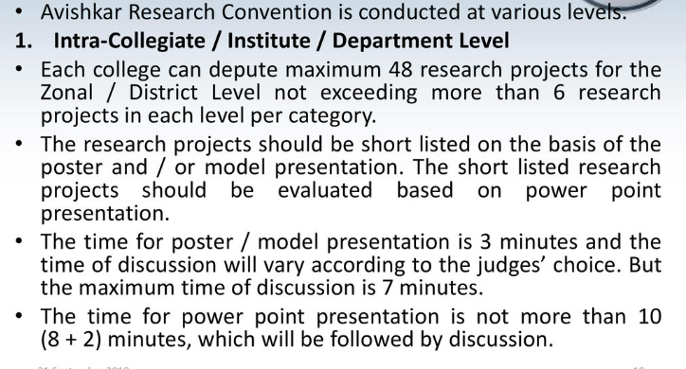

Slide 13
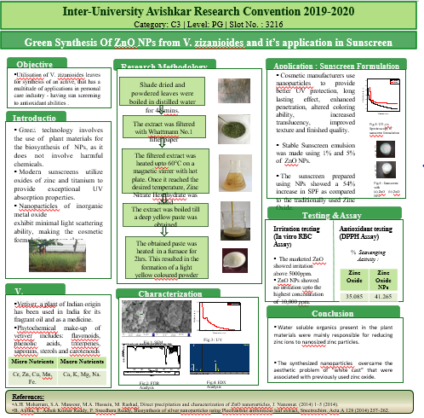
Example of poster presentation

Slide 14
Guidelines for making of Presentation
The presentation can be made by using any tool or application but the supporting file/s or software must be installed in the presenter’s device to avoid the last-minute delay/chaos.
Keep your presentation handy, possibly on the clean desktop.
Use minimum text on the slide/s.
Make use of suitable pictures / diagrams / graphs / tables, etc. in the presentation.
Keep the slides limited so as to finish presentation within the required time specified for competition.
The title and the slot number (to be displayed on the portal two days prior to the competition) of the research proposal should be mentioned on the first slide.
Do not mention the name of the participant or the college/institute/department on any of the slides.
Introduce yourself only with a slot number and do not reveal the identity or name of the college/institute/department during the presentation.

Slide 15
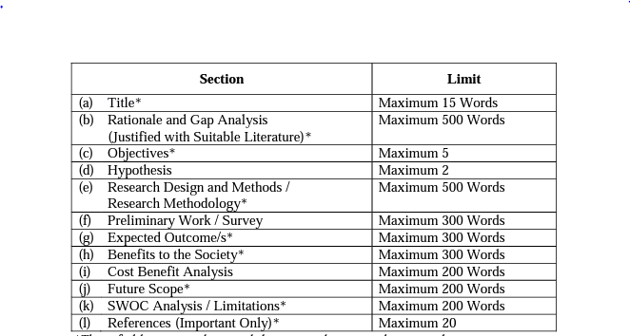
Research Proposal must include :
The research proposal will be in the PDF format and size of the PDF will not be more than 20 MB.

Slide 16
Example of Research Proposal

Slide 17
How to register?
Online Registration for Participation
Every interested College / Recognized Institute / University Department shall register themselves online on the portal available on the website www.unimumbaidsd.com
Steps for Registration
Sign-up
Details of the College
Details of the Principal / Director / Head
Details of the Teacher Co-ordinator
Details of the Student Co-ordinator (Male)
Details of the Student Co-ordinator (Female)
Details of the Research Proposal
Details of the Participating Student/s
Details of Mentor/s

Slide 18
How to register?
Registration Fees
The Registration Fees is Rs. 50 per research proposal.
The Registration Fees will be charged for Zonal / District level only and it will not be charged for University level.
The Registration Fees is to be paid through cheque along with printouts of Consolidated Entry Form. The cheque should be drawn in favour of ‘Finance and Accounts Officer, University of Mumbai’. In any case Registration Fees will not be accepted in cash. The College / Recognized Institute / University Department shall send the cheque along with printout of Consolidated Entry Form to the Director, Department Students’ Development, First Floor, Vidyapeeth Vidyarthi Bhavan, ‘B’ Road, Churchgate, PIN.-400 020.
The Registration Fees will not be refunded under any circumstances even though the entries are cancelled.

Slide 19
Awards and Honours
Selection Round
Certificate of Participation
Certificate of Merit
Zonal / District Championship
Final Round
Certificate of Participation
Certificate of Merit
Zonal / District Championship
Category-wise Championship
Overall Championship
Overall Runner Championship
Overall Second Runner Championship

Slide 20
Avishkar winners 2019-2020
Two students of PGDPCM Ms. Vrushali Inamdar and Ms. Shraddha Suresh bagged silver medal in final university level round in the year 2019-2020.
They were guided by Dr Paresh More, Associate Professor from Department of Chemistry.

Slide 21
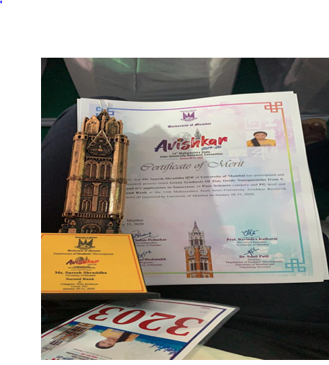
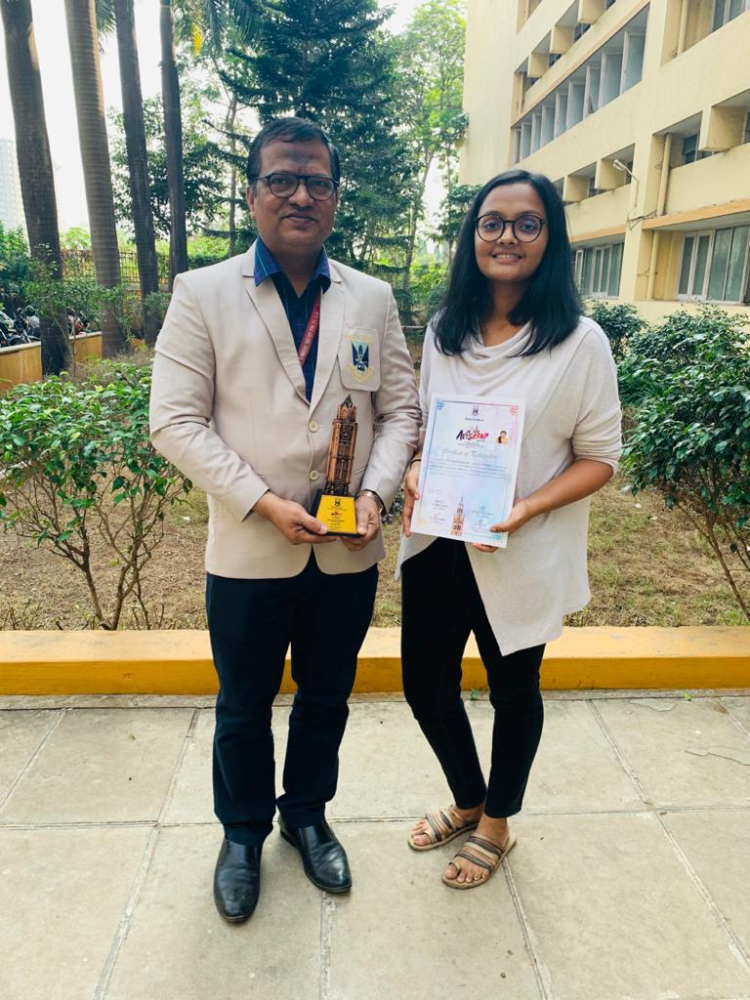

Slide 22
